Slide 1
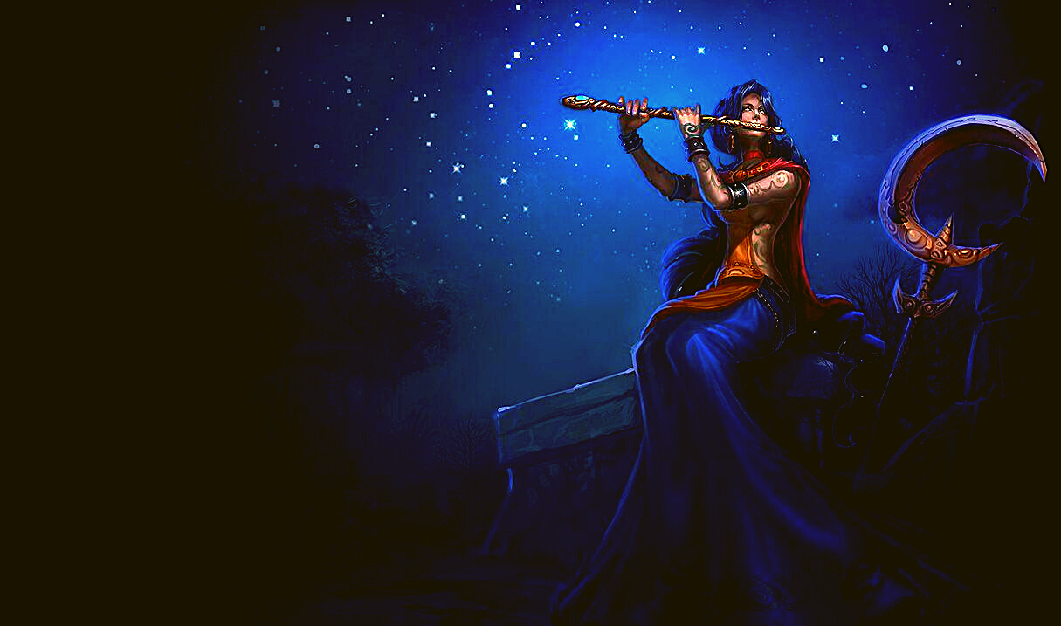
MAUSALYA PARVA

Slide 2



S.Abhishek
Sanjana Nayar
Rohit Menon
Sasidhar Yepuri

Slide 3




Hey, this is Sanjana Nayar!!
I will take over the session now.

Slide 4
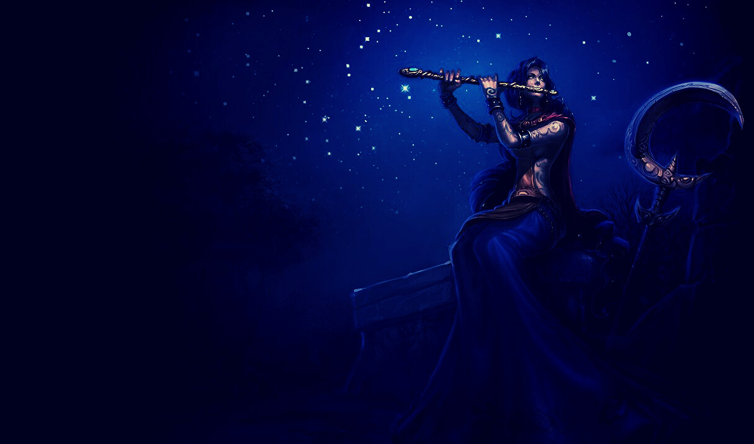
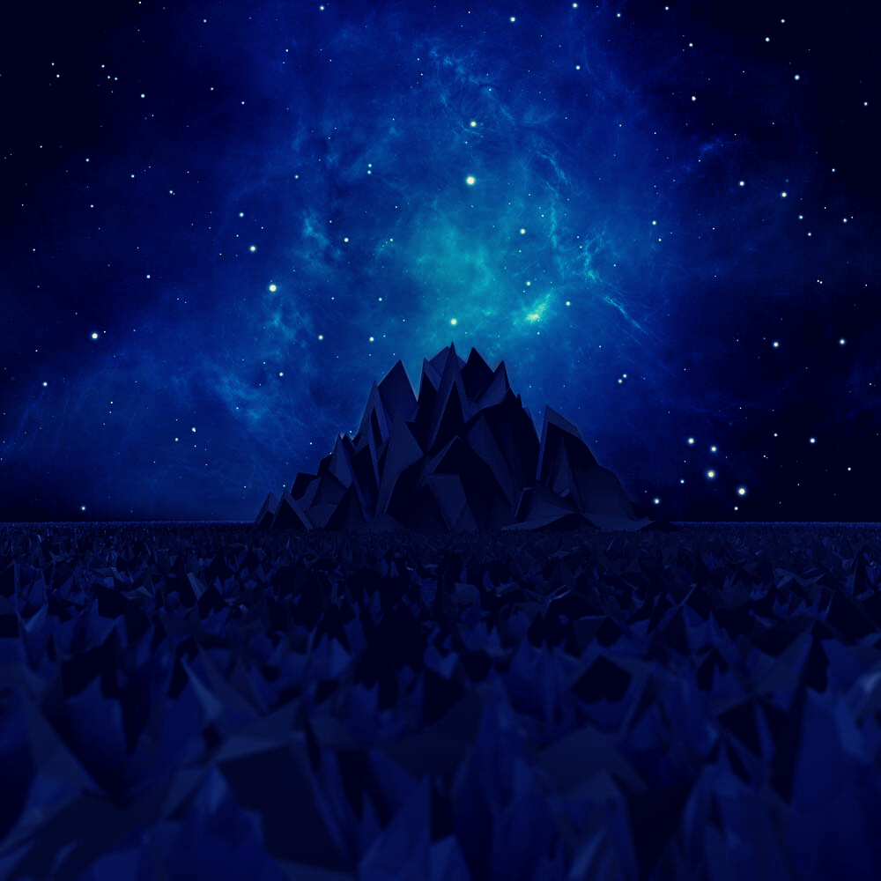
Introduction to Mausala Parva
Mausala Parva or the "Book of Clubs", is the sixteenth of eighteen books of the Indian epic Mahabharata.
It traditionally has nine chapters.
The critical edition has eight chapters.
It is one of three shortest books in the Mahabharata.
Mausala Parva describes the demise of Krishna in the 36th year after the Kurukshetra war

Slide 5
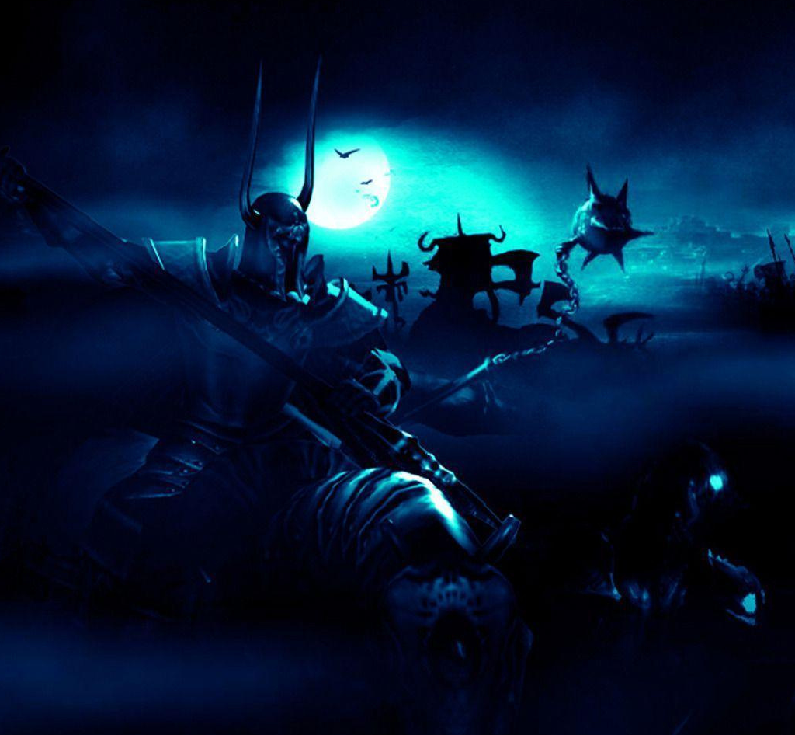
Structure and Chapters
Mausala Parva traditionally has 9 Adhyayas and has no secondary sub-parvas.
Of the 80,000 verses in the critical edition of the Mahabharata - Mausala parva represents about 0.25% of all verses of the Epic.

Slide 6

Background Of Mausalya Parva

Slide 7
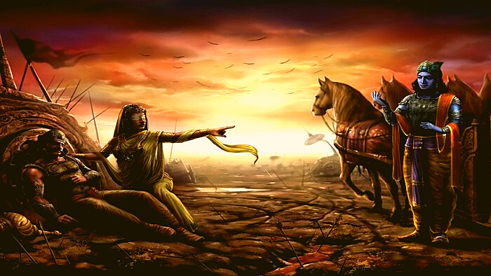
First curse
Gandhari's curse

Slide 8

In days after the 18-day Kurukshetra war, Lord Krishna meets Gandhari, a meeting described in Stri Parva.
In anger and grief over the death of her sons and the Kaurava soldiers, Gandhari curses Krishna.
She Cursed that the Yadavas will be destructed in a manner similar to the death of her sons.

Slide 9
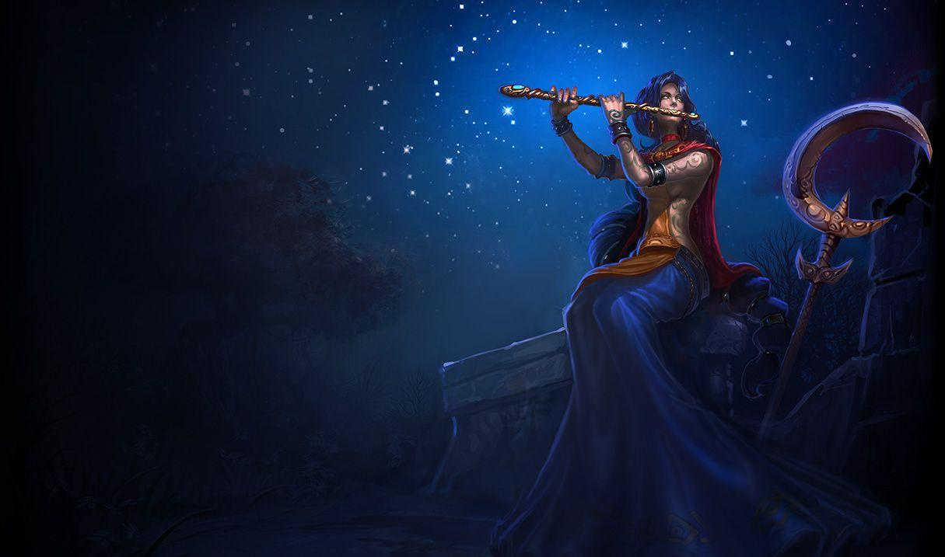
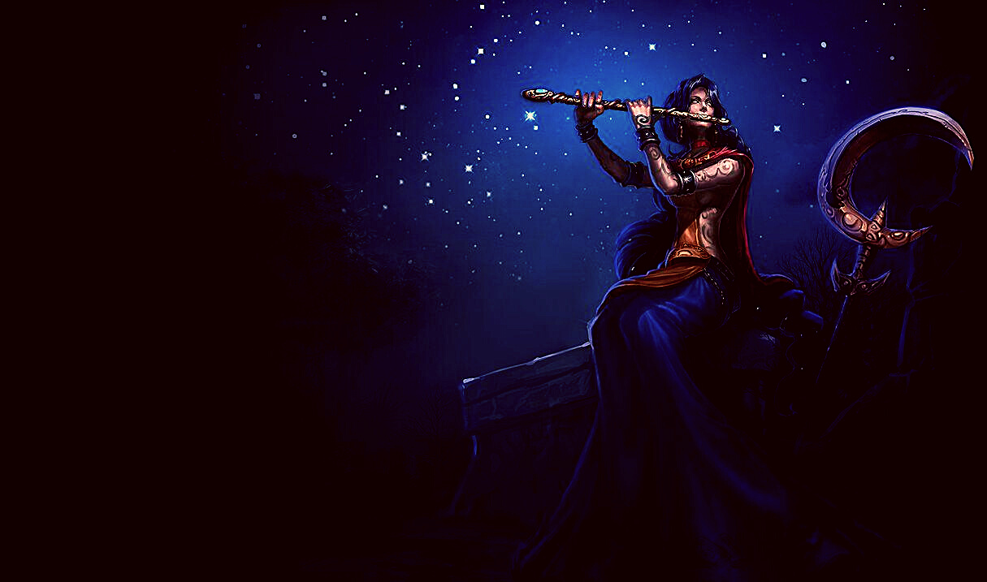
She blames Krishna for his inaction and believes that he could have prevented the war and the slaughter of hundreds of millions people who died in the war.
Krishna accepts the curse because he thought the Yadavs that day were being very adharmi, explains how he had tried many times to mediate peace, how Duryodhana refused.
He also explained how Duryodhana and the Kauravas had tried many times to kill the Pandavas.

Slide 10
Now I hand over the session to my friend Abhishek S

Slide 11



Thanks Sanjana,that was a good Intro!!
Hey all, now I will take you to the next curse!!

Slide 12
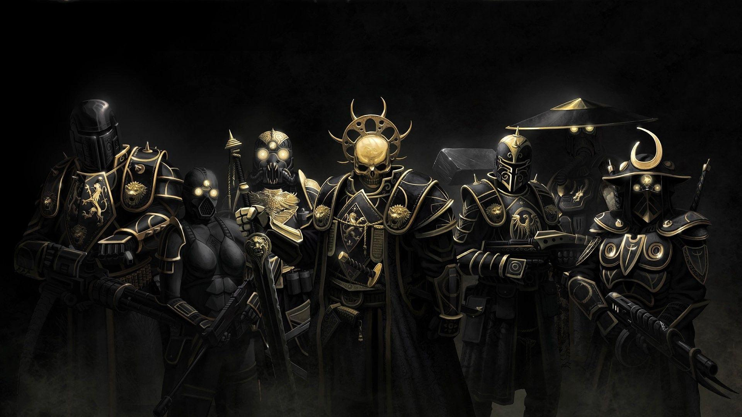
The second curse
The curse of the sages

Slide 13

The empire is peaceful and prosperous, the youth of Yadavas have become frivolous and hedonistic.
Krishna's son Samba dresses up as a woman and his friends meet Rishi Vishwamitra, Durvasa, Vashista, Narada and other Rishis, who were visiting Dwaraka for an audience with Krishna.

Slide 14

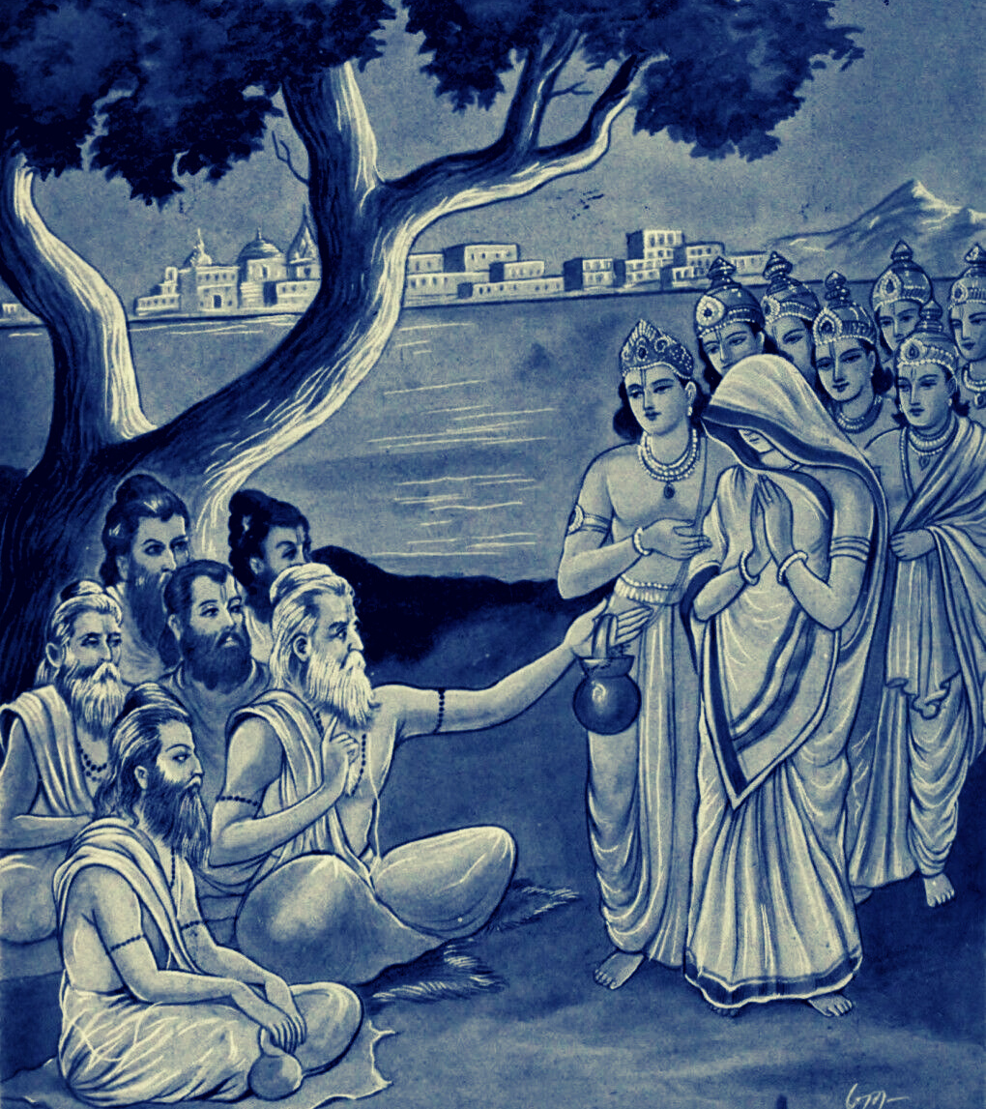
The young man playfully pretending to be a woman claims he is pregnant, and asks the rishis to predict the gender of the baby.
One rishi sees through the prank. In a fit of rage, he curses Samba will give birth to an iron bolt that will destroy his entire race.

Slide 15
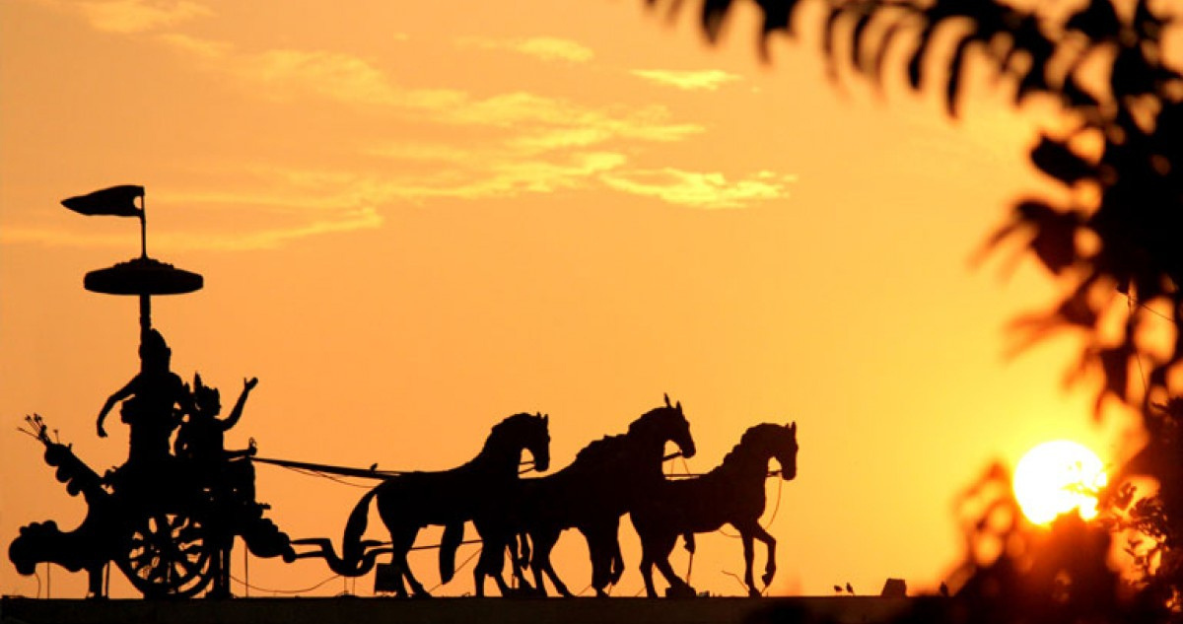
Samba Gives Birth To Iron Bolt

Slide 16







The boys panic and go to King Ugrasena and narrate the whole incident.
Ugrasena advises them to grind the lump into a fine powder and dump it in the sea.
They do as instructed but are unable to grind the entire lump into fine powder.
A small piece of Iron couldn't be crushed.

Slide 17
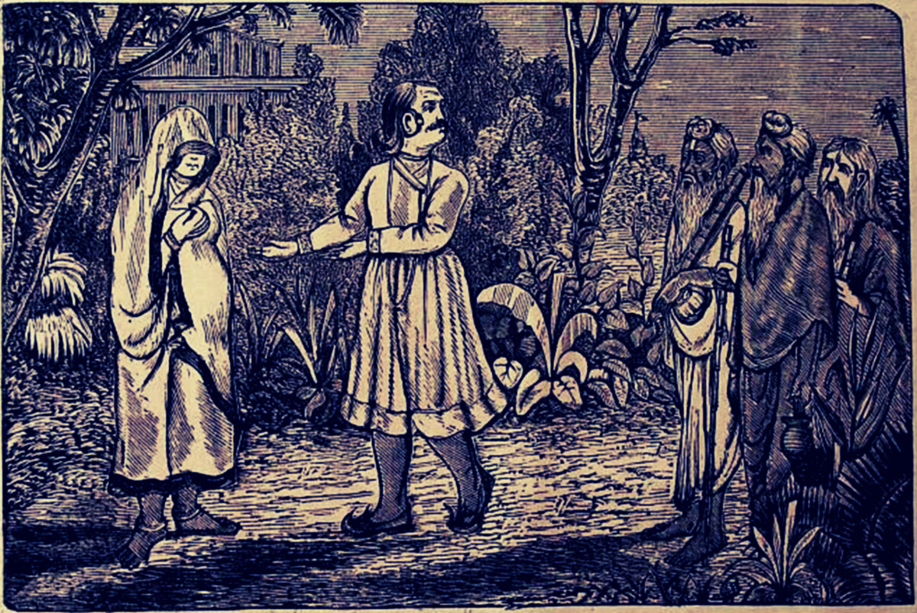



The boys discarded the powdered iron and the remaining piece in the Prabhasa sea.
Assuming Krishna had no knowledge of all that occurred the boys are at peace.
The powder gets deposited on the sea coast and grow like stalks of bamboo.

Slide 18
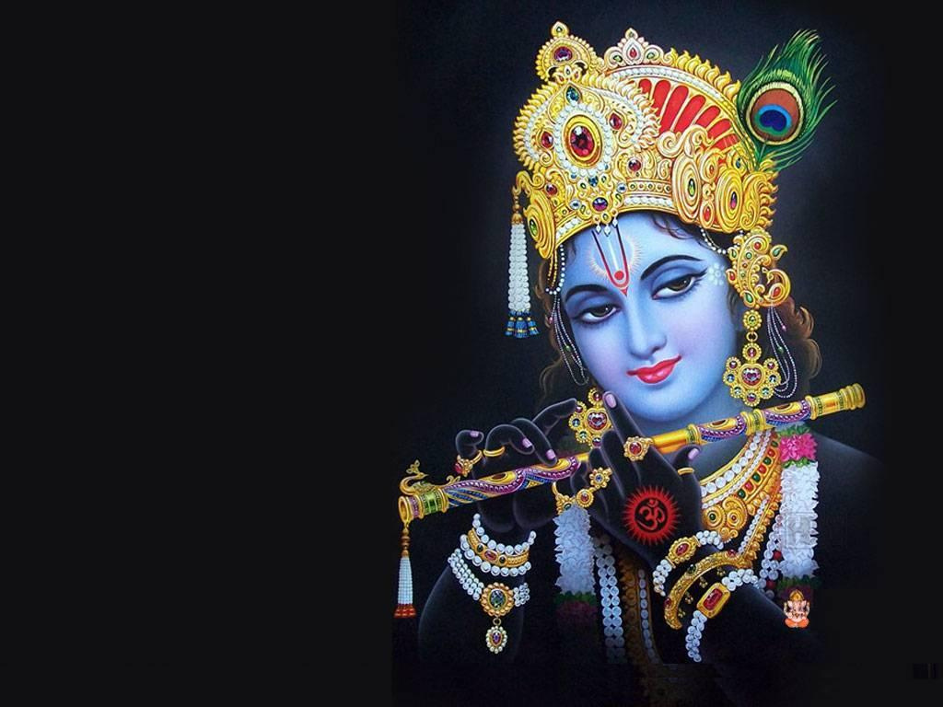
The third curse
Krishna Curses His Wives And His Son Samba

Slide 19
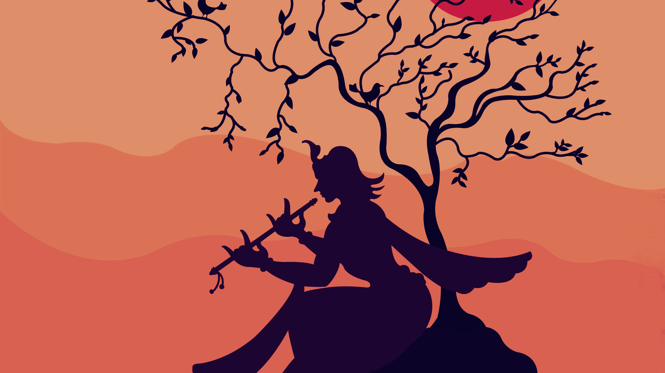

Samba was the son of Krishna and Jambavati.
He was very handsome and good looking.
He was the cause of the third curse.
Once, Narad visited Dwaraka to accomplish the tasks of Bhagwan Krishna.
But, Samba did not pay respect to him.

Slide 20
In order to teach him a lesson, Narada offered alcohol to various wives of Krishna and Samba.
After drinking too much of alcohol, the wives of Krishna lost their senses and control.
When the drunk wives of Krishna who were related to Samba as mother, ventured to have relationship with their son Samba, then Krishna came to know the ill-intentions of his wives.
He cursed Samba to suffer from leprosy to lose his attractiveness.

Slide 21

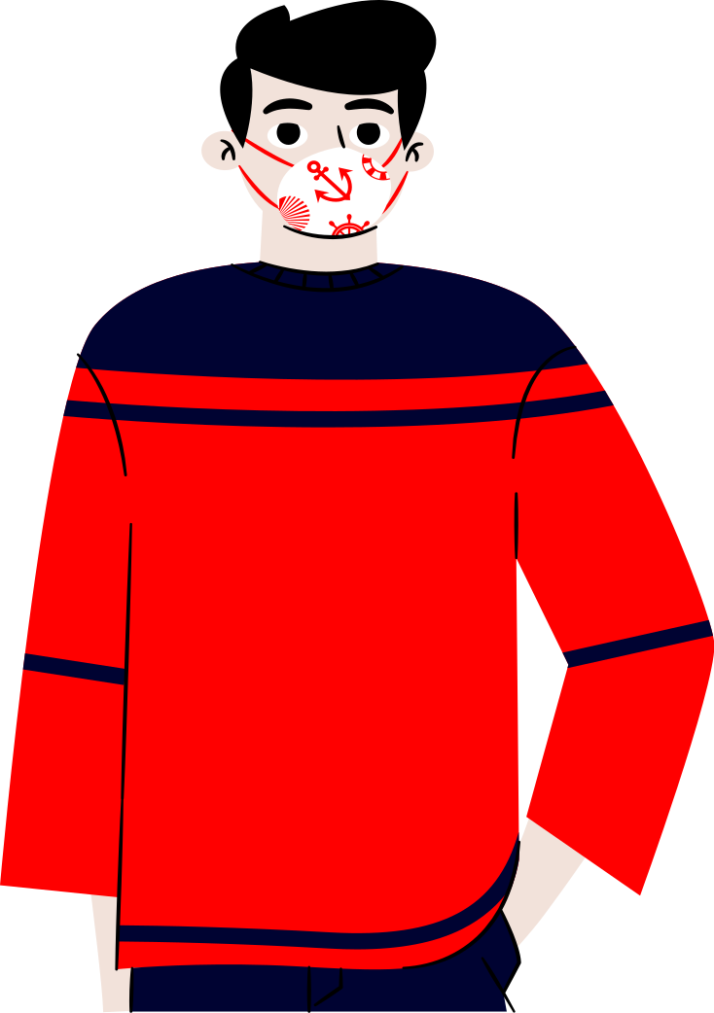

Thanks Abhishek, Hey all, this is Rohit Menon.
Lets, continue to get to know about the Destruction of Yadavas.

Slide 22
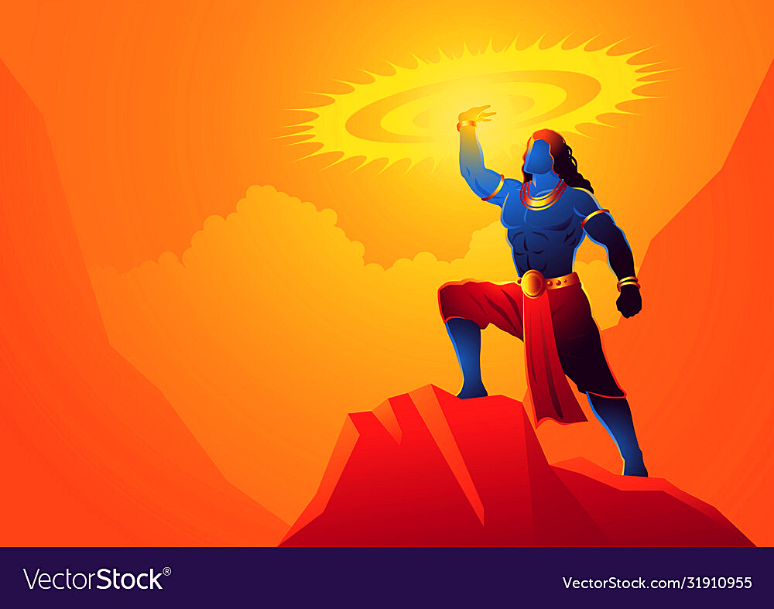
destruction of yadavas

Slide 23
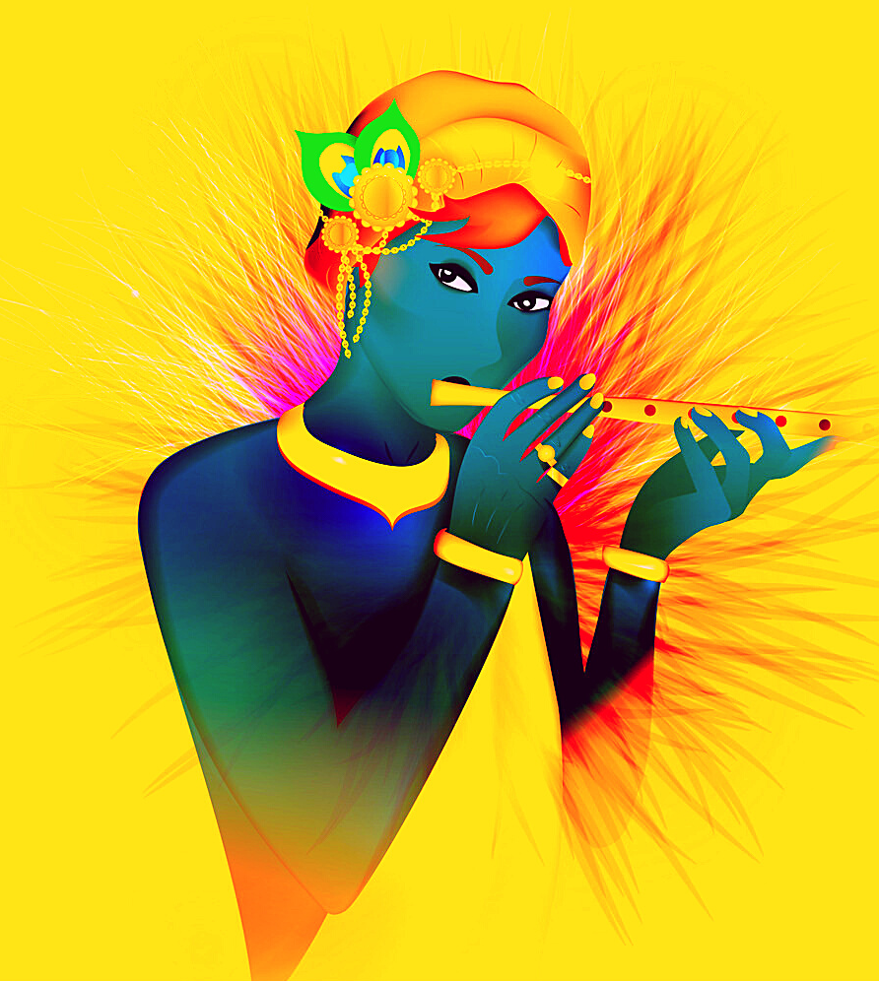
After 36 years of Mahabharat war, lots of divine associates of Bhagwan Krishna disappeared from the Dwaraka city.
The Sudarshana chakra, Panchajanya shankh, the Maharatha Daruga chariot of lord Krishna and the Plough weapon of Balarama left earth.

Slide 24
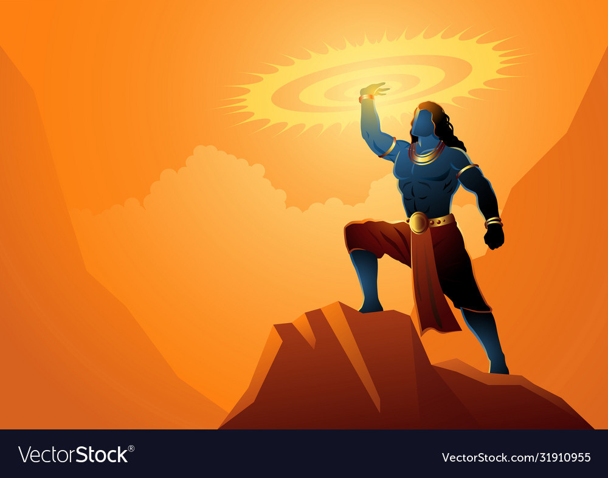
This was seen as a sign of final destruction among the Yadavas.
They approached Krishna.
Bhagwan Krishna suggested them to visit various holy places and to take bath in holy water at each places.
Following advice, the Yadavas were on pilgrimage to various places.
They all soon came to a place named Prabasha.

Slide 25
In the past, Satyaki and Kritavarma fought on the side of Pandavas and Kauravas respectively in the Mahabharata war.
They were one of the few handful survivors of Mahabharata war.
Their battle exploits in the Mahabharata war becomes the starting point to trigger the conflict among the Yadava men.
Pradyumna tries to stop the fight, but in vain.
Satyaki took his sword and killed Krita varma.
Now, the Yadava men start dividing themselves into two groups.

Slide 26
All start fighting with each other by using swords, bows and arrows.
After a huge fight, Satyaki got killed.
However, sooner all their ammunition gets consumed.
So, each one of them take the bamboos (clubs) that were grown nearby in Prabasha and hit each other.

Slide 27
I request Sasidhar yepuri to take over the session.

Slide 28


Hey guys, come on let's conclude

Slide 29
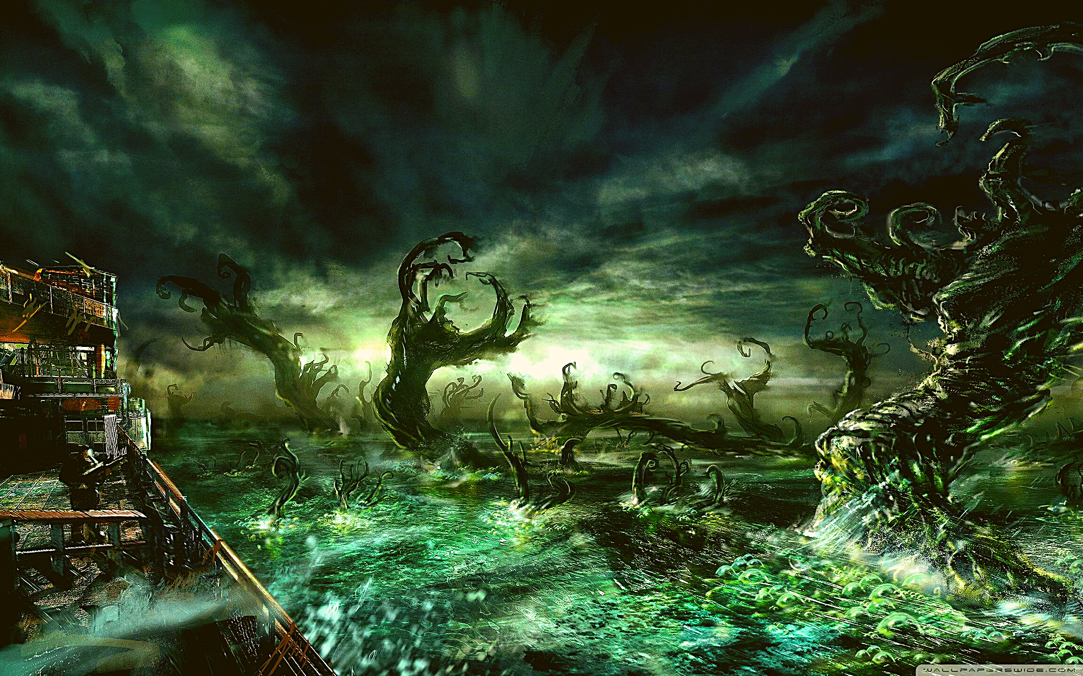
end of krishna leela

Slide 30
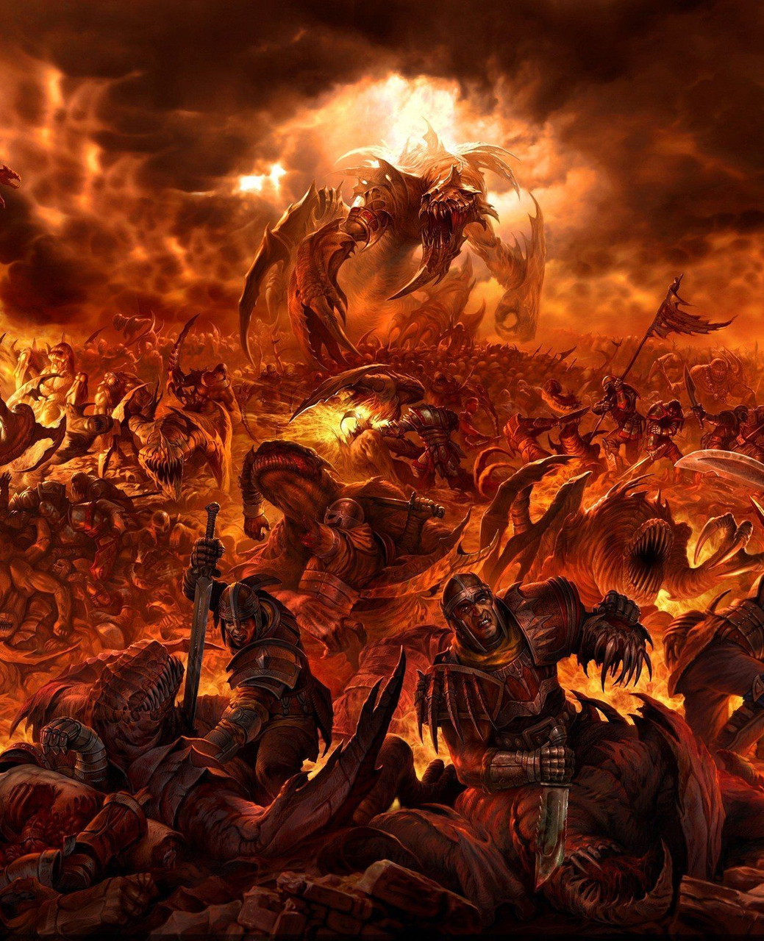
In the past, the small (uncrushed, not powdered) piece of Iron that was dropped inside the seacoast in Prabasha will be swallowed by a fish.
An hunter by name Jara caught the fish and got the Iron piece from its stomach.
He makes them sharp, adds poison to it and fixes them at the edge of his arrows.

Slide 31
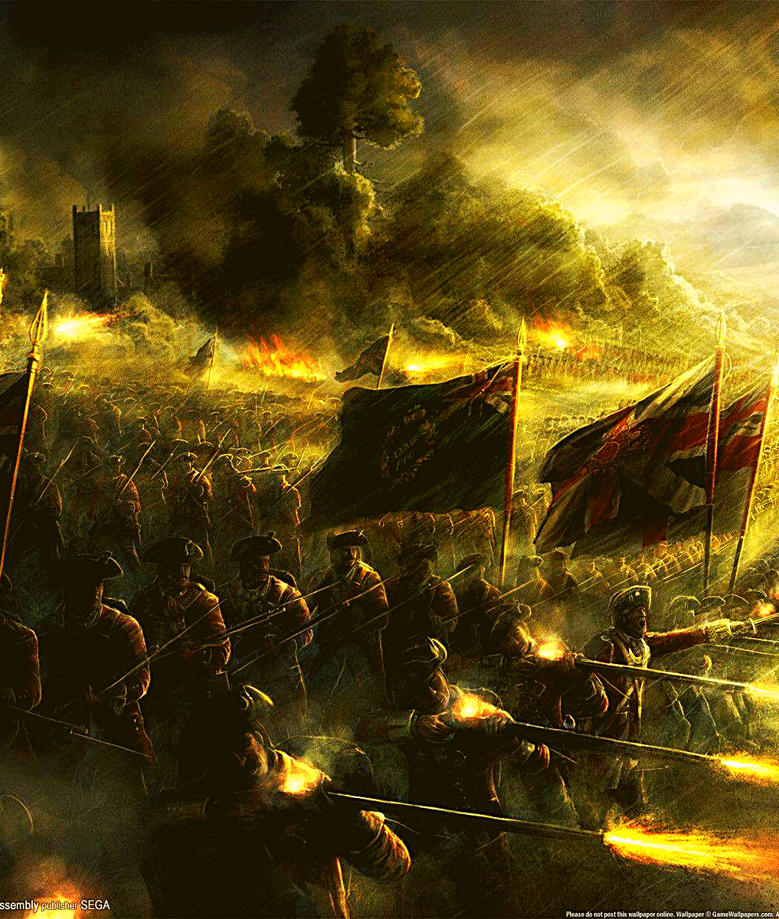
The Hunter looks at Krishna's feet.
He mistakes it as the face of a deer and aims his arrow at and shoots an arrow.
The arrow hits Krishna's left foot.
The Hunter comes towards the deer and soon realised that it was Bhagwan Krishna and not a deer.
He realised his mistake and pleads the Bhagwan for forgiveness of his sin.

Slide 32
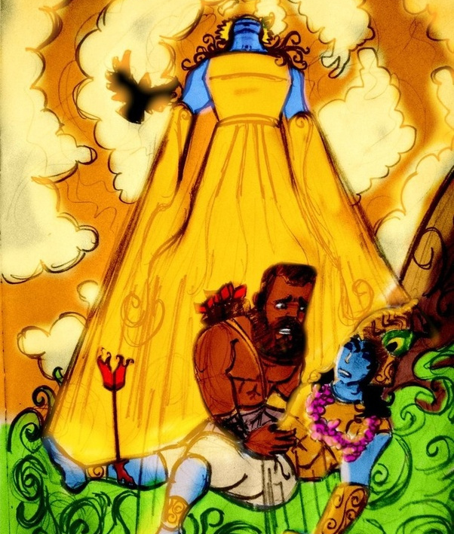
Bhagwan Krishna consoles him and says that in his previous birth as Sree Ram in the Tretayuga, Ram killed Baali(Sugreeva's brother) from behind.
So, Krishna has now reaped the Prarabdh for the same Karma through Jara who was king Baali in his previous birth.
Bhagwan Krishna left the mortal world.

Slide 33


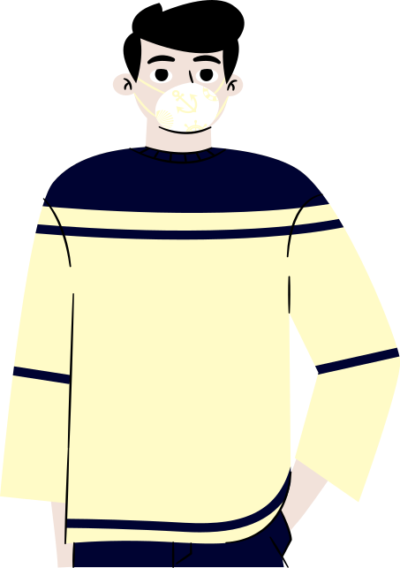

Hey guy's, we hope you got an idea about Mausalya Parva.

Slide 34



Thankyou!!

